Slide 1

MACHINE LEARNING REGRESSION
LOGISTIC
REGRESSION

Slide 2
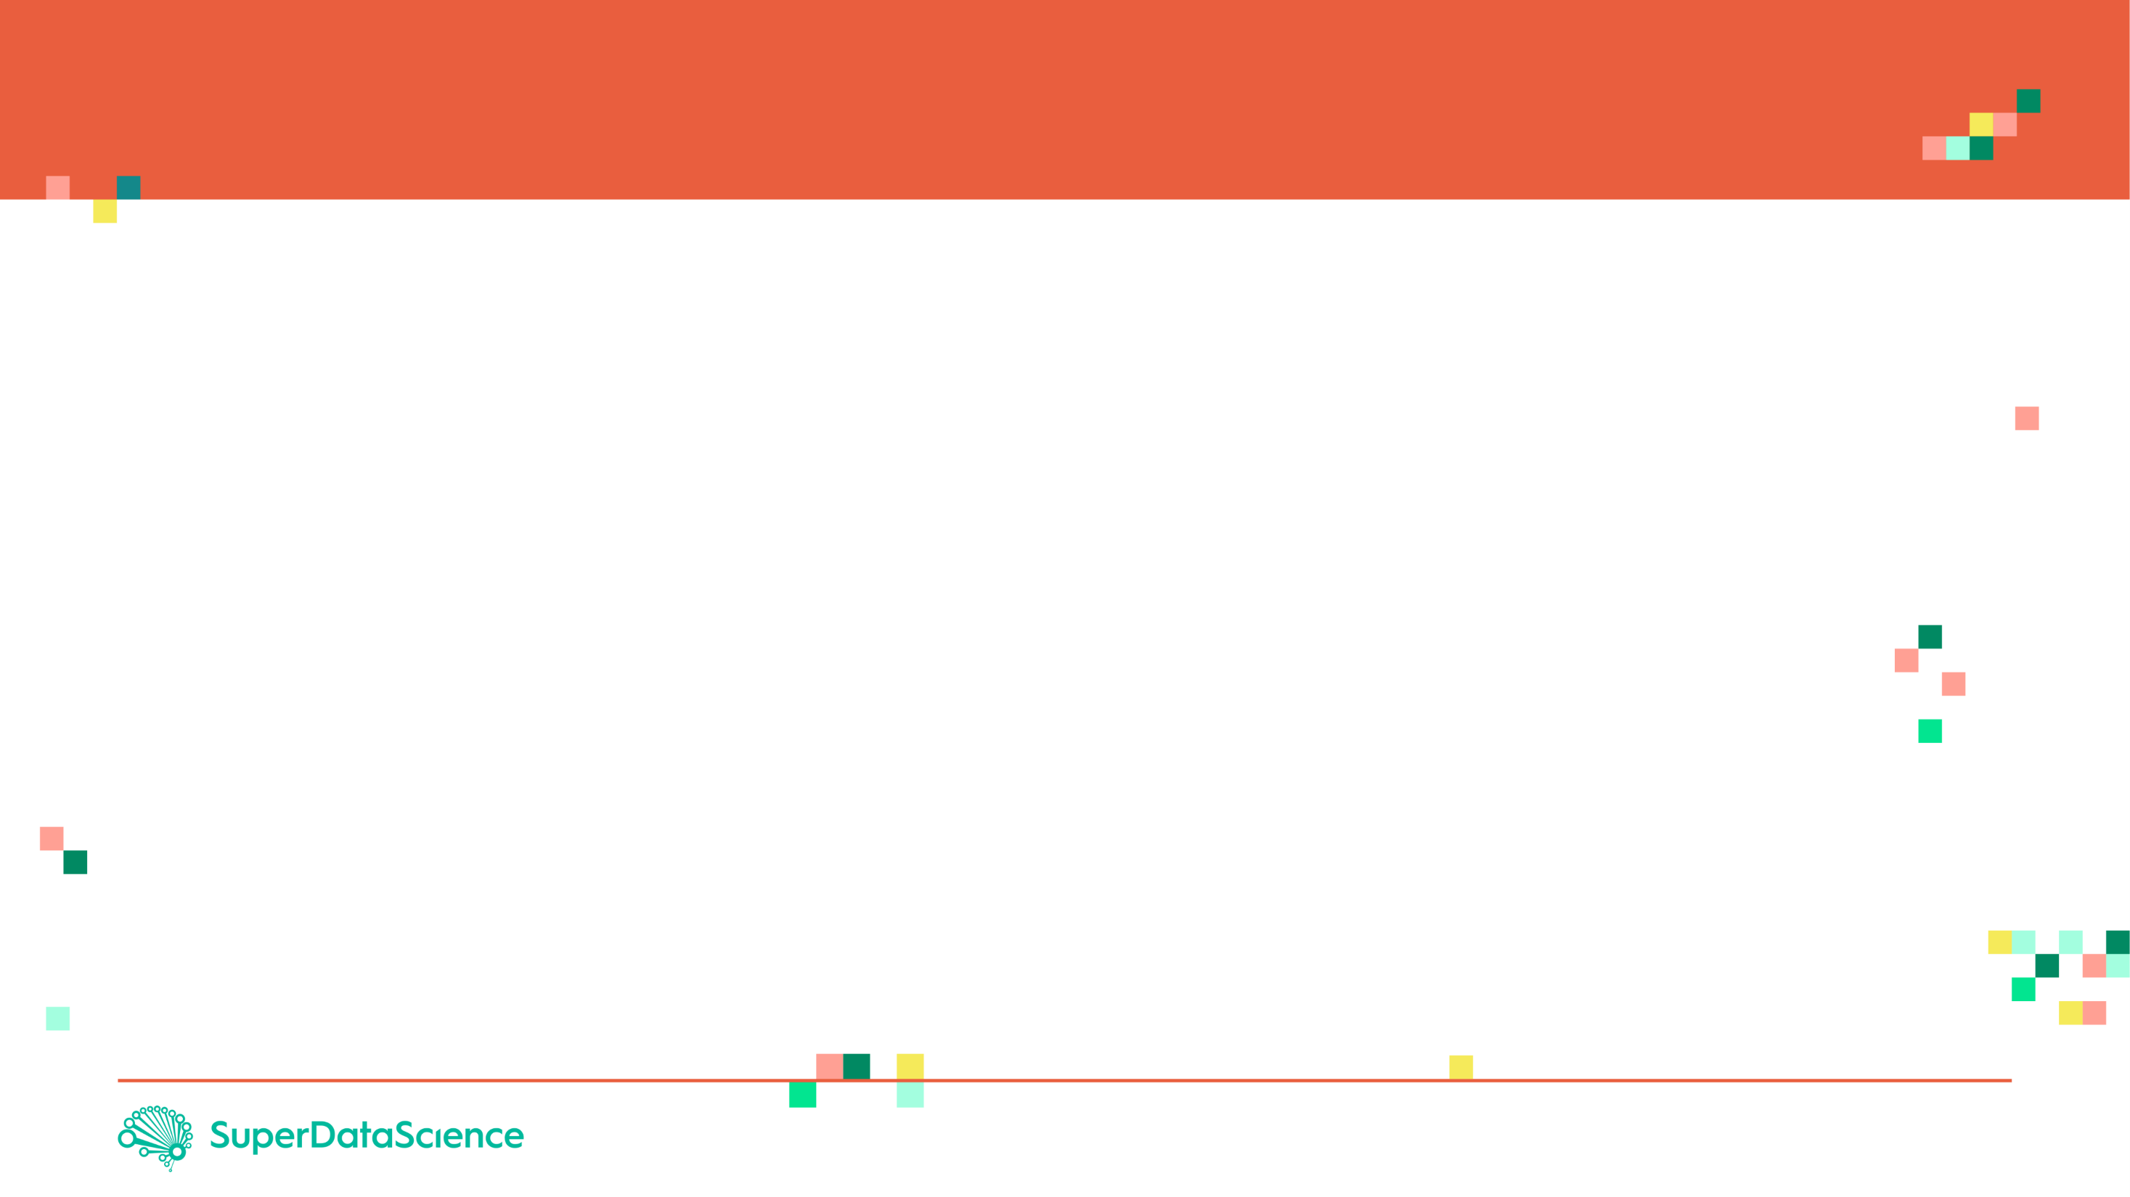

LOGISTIC REGRESSION: INTUITION
Linear regression is used to predict outputs on a continuous spectrum.
Example: predicting revenue based on the outside air temperature.
Logistic regression is used to predict binary outputs with 2 possible values (0 or 1)
Logistic model output can be one of two classes: pass/fail, win/lose, healthy/sick
Hours Studying | Pass/Fail
1 | 0
1.5 | 0
2 | 0
3 | 1
3.25 | 0
4 | 1
5 | 1
6 | 1
PASS/FAIL
LINEAR MODEL
HOURS OF STUDYING

Slide 3
LOGISTIC REGRESSION: INTUITION
Linear regression is not suitable for classification problem.
Linear regression is unbounded, so logistic regression will be better candidate in which the output value ranges from 0 to 1.
LINEAR MODEL
PASS/FAIL
LOGISTIC REGRESSION MODEL
HOURS OF STUDYING

Slide 4

LOGISTIC REGRESSION: MATH
Linear regression is not suitable for classification problem.
Linear regression is unbounded, so logistic regression will be better candidate in which the output value ranges from 0 to 1.
Linear equation:
$y=b_{0}+b_{1}∗x$
Apply Sigmoid function:
$P\left(x\right)= sigmoid \left(y\right)$
$P\left(x\right)=\frac{1}{1+e^{−y}}$
$P\left(x\right)=\frac{1}{1+e^{−(b_{0}+b_{1}∗x)}}$
PASS/FAIL
LOGISTIC REGRESSION MODEL
HOURS OF STUDYING

Slide 5

LOGISTIC REGRESSION: FROM PROBABILITY TO CLASS
Now we need to convert from a probability to a class value which is “0” or “1”.
Linear equation:
$y=b_{0}+b_{1}∗x$
Apply Sigmoid function:
$P\left(x\right)= sigmoid \left(y\right)$
$P\left(x\right)=\frac{1}{1+e^{−y}}$
Class 1
LOGISTIC REGRESSION MODEL
PASS/FAIL
0.5
Class 0
THRESHOLD
HOURS OF STUDYING

Slide 6
MACHINE LEARNING REGRESSION
PERFORMANCE ASSESSMENT

Slide 7
CONFUSION MATRIX
TRUE CLASS
+
-
TYPE I ERROR
+
TRUE +
FALSE +
PREDICTIONS
FALSE -
TRUE -
-
TYPE II ERROR

Slide 8
CONFUSION MATRIX
A confusion matrix is used to describe the performance of a classiﬁcation model:
True positives (TP): cases when classiﬁer predicted TRUE (they have the disease), and correct class was TRUE (patient has disease).
True negatives (TN): cases when model predicted FALSE (no disease), and correct class was FALSE (patient do not have disease).
False positives (FP) (Type I error): classiﬁer predicted TRUE, but correct class was FALSE (patient did not have disease).
False negatives (FN) (Type II error): classiﬁer predicted FALSE (patient do not have disease), but they actually do have the disease

Slide 9
KEY PERFORMANCE INDICATORS (KPI)
Classiﬁcation Accuracy = (TP+TN) / (TP + TN + FP + FN)
Misclassiﬁcation rate (Error Rate) = (FP + FN) / (TP + TN + FP + FN)
Precision = TP/Total TRUE Predictions = TP/ (TP+FP) (When model predicted TRUE class, how often was it right?)
Recall = TP/ Actual TRUE = TP/ (TP+FN) (when the class was actually TRUE, how often did the classiﬁer get it right?)

Slide 10
KEY PERFORMANCE INDICATORS (KPI)
Accuracy
“How many predictions were correct out of all predictions made.”
“Out of everything I guessed, how many did I get right?”
Example: You took a test with 100 questions and got 90 right,
Your accuracy is 90%

Slide 11
KEY PERFORMANCE INDICATORS (KPI)
Precision
“Out of all the time you predicted ‘positive’, how many were actually positive?.”
“When I say someone has the disease, how often am I right?”
Example: If a model predicted 10 people had a disease, but only 7 really did, precision is 7/10 = 70%

Slide 12
KEY PERFORMANCE INDICATORS (KPI)
Recall (Sensitivity or True Positive Rate)
“Out of all the people who actually had the disease, how many did you successfully find?”
“How good am I at catching the real positives?”
Example: If 10 people had the disease and your model correctly predicted 7 of them, recall is 7/10 = 70%

Slide 13
KEY PERFORMANCE INDICATORS (KPI)
F1 Score
It is a balance between precision and recall
“Let’s find a good middle ground between being right when I say ‘positive’ (precision) and not missing real positives (recall)”
Example: If precision = 70% and recall = 70%, the F1 Score is also 70%. If one is high and the other is low, the F1 Score will be closer to the lower value.

Slide 14
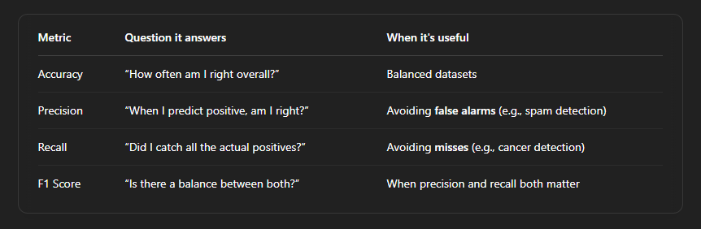
KEY PERFORMANCE INDICATORS (KPI)

Slide 15
PRECISION Vs. RECALL EXAMPLE
TRUE CLASS
+
-
TP = 1
FP = 1
+
PREDICTIONS
-
FN = 8
TN = 90
Classiﬁcation Accuracy = (TP+TN) / (TP + TN + FP + FN) = 91%
Precision = TP/Total TRUE Predictions = TP/ (TP+FP) = ½=50%
Recall = TP/ Actual TRUE = TP/ (TP+FN) = 1/9 = 11%

